Slide 1
Geography and Trade on the Arabian Peninsula
History Alive Chapter 6

Slide 2
Vocabulary Review
Arab
Arabian Peninsula
Islam
Muhammad
Caravan

Slide 3
Trade and the Arabian Peninsula
The Arabian Peninsula was located at the very heart of trade between China, India, Persia, Europe, and Africa. As a result, Arabians became the “middlemen” of medieval trade.

Slide 4
Trade by land: caravans
Arabs used camels to carry their goods across the deserts on the Arabian Peninsula.
Camels could go for days without drinking water and could survive the difficult journey.
"Isle of Graia Gulf of Akabah Arabia Petraea“ by Louis Haghe

Slide 5
The impact of trade on Arabia
Knowledge
Ideas
Technology
Goods

Slide 6
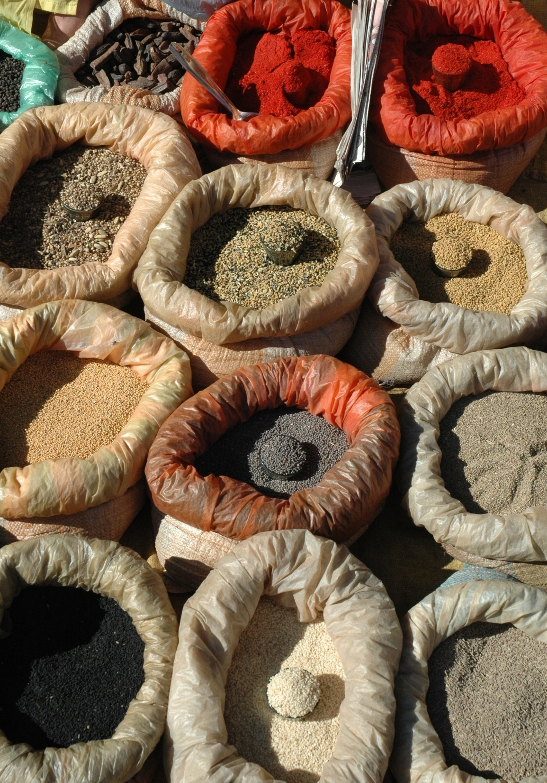
Goods
Silks (China)
Jewels, cotton,
spices, (India)
Ivory, gold (Africa)
Glass, gold (Rome)

Slide 7
The End

